Slide 1
Spring Data JPA

Slide 2
Agenda
What is Spring Data
Configurations
Domain/Entities
Persistent Identity
Identifier Generation
Customizing the Entity Object
Entity Relationships
Entity Inheritance
EntityManager & the Persistent Context
Repository and Repository Hierarchy
User Defined Repository
Defining Query methods
Pageable
Query creation : Custom Queries and Named Queries
Custom Interfaces
Accessing Spring Data with rest
Transactional
Disadvantages

Slide 3
What and Why ?
Spring Data is a high level SpringSource project whose purpose is to unify and ease the access to different kinds of persistence stores, both relational database systems and NoSQL data stores.
Features
Powerful repository and custom object-mapping abstractions
Dynamic query derivation from repository method names
Implementation domain base classes providing basic properties
Support for transparent auditing
Possibility to integrate custom repository code
Advanced integration with Spring MVC controllers
Several modules such as : Spring Data JPA, Spring Data MongoDB, Spring Data REST, Spring Data Cassandra etc.

Slide 4
Configuration
Dependencies :
compile('mysql:mysql-connector-java:5.1.6')
compile('org.springframework.boot:spring-boot-starter-data-jpa')
Setting :
spring:
datasource:
url: jdbc:mysql://localhost:3306/spring_jpa?autoReconnect=true&useUnicode=true&CharSet=UTF-8&characterEncoding=UTF-8
username: root
password: igdefault
driverClassName: com.mysql.jdbc.Driver
jpa:
hibernate.ddl-auto: create-drop
show-sql: true
4

Slide 5
Domain/Entities
An entity is a plain old java object (POJO)
Requirements:
annotated with the javax.persistence.Entity annotation
public or protected, no-argument constructor
the class must not be declared final
no methods or persistent instance variables must be declared final
Entities may extend both entity and non-entity classes
Persistent instance variables must be declared private, protected
import javax.persistence.*;
@Entity
public class User {
private String email;
private String name;
}
5

Slide 6
Persistent Identity
Each entity must have a unique object identifier (persistent identifier)
Identifier (id) in entity = primary key in database
Example :
import javax.persistence.*;
public class User {
@Id
private Long id;
}
6

Slide 7
Identity Generation
Identifiers can be generated in the database by specifying @GeneratedValue on the identifier
Four pre-defined generation strategies:
AUTO,
IDENTITY,
SEQUENCE,
TABLE
Specifying strategy of AUTO indicates that the provider will choose a strategy
Example:
import javax.persistence.*;
public class User {
@Id
@GeneratedValue(strategy = GenerationType.AUTO)
private Long id;
}
7

Slide 8
Customizing the Entity Object
In most of the cases, the defaults are sufficient
By default the table name corresponds to the unqualified name of the class
Customization:
@Entity
@Table(name = "user")
public class User {}
The defaults of columns can be customized using the @Column annotation
@Column(nullable = true, unique = true)
private String email;
@Column(name = "full_name", nullable = false, length = 25)
private String name;
8

Slide 9
Entity Relationships
There are four types of relationship multiplicities:
@OneToOne
@OneToMany
@ManyToOne
@ManyToMany
The direction of a relationship can be:
bidirectional – owning side and inverse side
unidirectional – owning side only
Supports cascading updates/deletes
You can declare performance strategy to use with fetching related rows
FetchType :
LAZY, EAGER
9

Slide 10
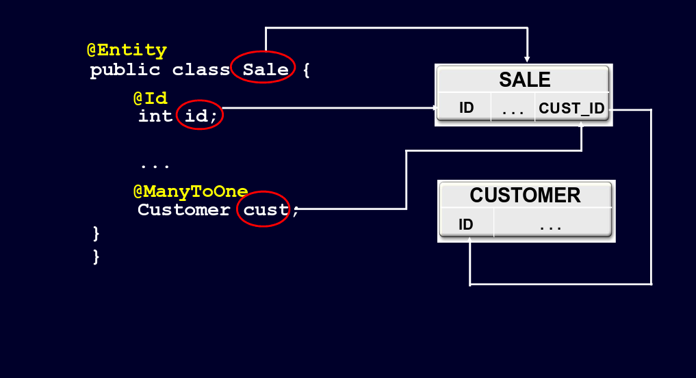
ManyToOne Mapping
10

Slide 11
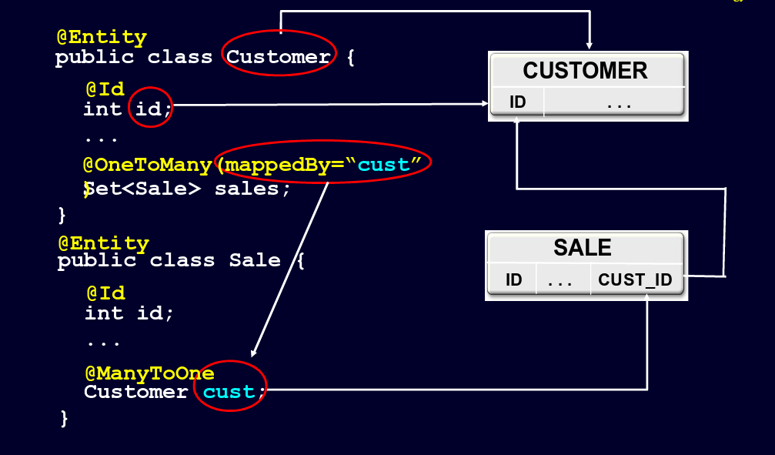
OneToMany Mapping
11

Slide 12
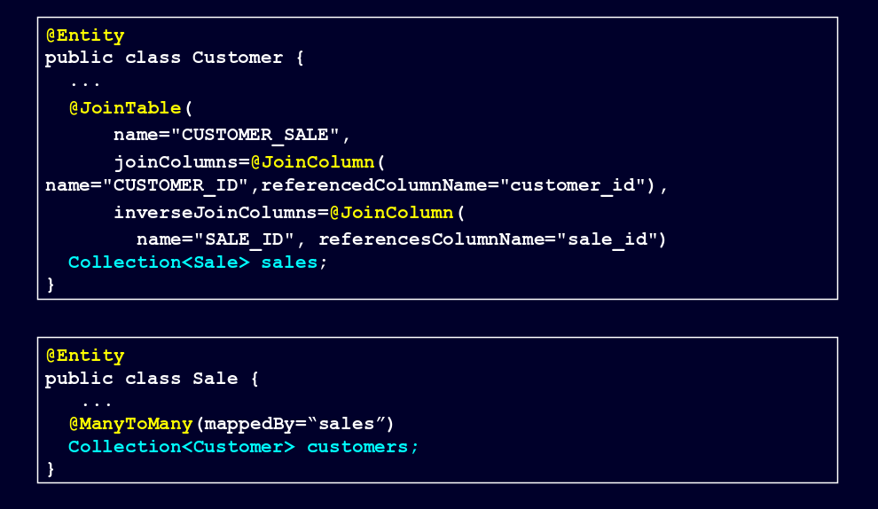
ManyToMany Mapping
12

Slide 13
Entity Inheritance
Entities can inherit from other entities and from non-entities
The @Inheritance annotation identifies a mapping strategy:
SINGLE_TABLE
JOINED
TABLE_PER_CLASS
SINGLE_TABLE strategy - all classes in the hierarchy are mapped to a single table in the database
Discriminator column - contains a value that identifies the subclass
Discriminator type - {STRING, CHAR, INTEGER}
Discriminator value - value entered into the discriminator column for each entity in a class hierarchy
13
Notes:
@TableGenerator(name = "empGen", allocationSize = 50)

Slide 14
Entity Inheritance : Example
@Entity
@Inheritance(strategy=InheritanceType.SINGLE_TABLE)
@DiscriminatorColumn(name="DISC", discriminatorType=DiscriminatorType.STRING)
@DiscriminatorValue(value="USER")
public class User { . . . }
@Entity
@DiscriminatorValue(value="PUSER")
public class PremiumUser extends User { . . . }
14

Slide 15
Managing Entities - JPA
Entities are managed by the entity manager
The entity manager is represented by javax.persistence.EntityManager instances
Each EntityManager instance is associated with a persistence context
A persistence context defines the scope under which particular entity instances are created, persisted, and removed
A persistence context is a set of managed entity instances that exist in a particular data store
Entities keyed by their persistent identity
Only one entity with a given persistent identity may exist in the persistence context
Entities are added to the persistence context, but are not individually removable (“detached”)
Controlled and managed by EntityManager
Contents of persistence context change as a result of operations on EntityManager API
15

Slide 16
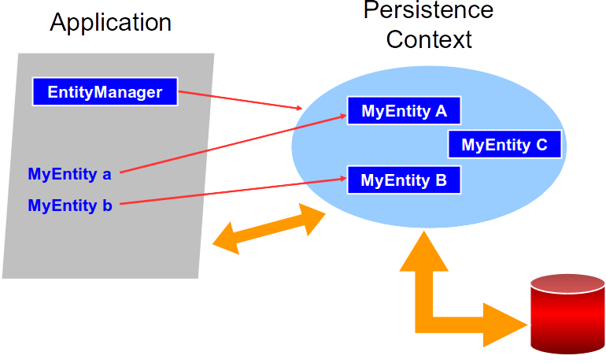
Persistence Context
16

Slide 17
Pains
A lot of code in the persistent framework and the DAO.
Duplicate code in concrete DAOs
Pagination need to handle yourself, and integrated from MVC to persistent layer.
If hybrid database (MySql + Mongo) are required for the system. It is not easy to have similar design concept in the Architecture.
17

Slide 18
Repository and Repository Hierarchy
The goal of the repository abstraction of Spring Data is to reduce the effort to implement data access layers for various persistence stores significantly.
The central marker interface
• Repository<T, ID extends Serializable>
Hierarchy :
Interface JpaRepository<T, ID>
interface PagingAndSortingRepository<T, ID>
interface CrudRepository<T, ID>
interface Repository<T, ID>
18
Notes:
CrudRepository is part of Spring Data Commons project and declared under the package org.springframework.data.repository. Where as JpaRepository is part of store specific implementation and declared under the packageorg.springframework.data.jpa.repository.

Slide 19
User Defined Repository
Spring Data Repository, you’ll have three options:
Using of a CRUD operations that implemented by the Spring Data infrastructure
Defining of a query methods and
Manually implementing your own custom repositories
Example :
public interface UserRepository extends JpaRepository<User, Long> {
}
19

Slide 20
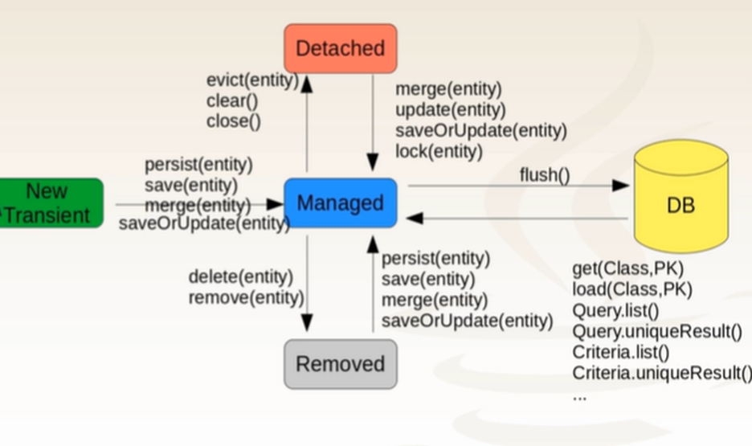
Entity Lifecycle

Slide 21
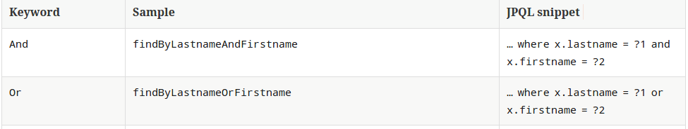
Defining Query methods
Query methods implemented in spring data repositories will be used for creating the dynamic queries.
public interface UserRepository extends JpaRepository<User, Long> {
User findByEmail(String email);
List<User> findAllByName(String name);
}
Reference : http://docs.spring.io/spring-data/jpa/docs/current/reference/html/
21

Slide 22
JPQL
The JPQL (Java Persistence Query Language) is an object-oriented query language
Used to perform database operations on persistent entities.
Instead of database table, JPQL uses entity object model to operate the SQL queries.
Here, the role of JPA is to transform JPQL into SQL.
Thus, it provides an easy platform for developers to handle SQL tasks.

Slide 23
JPQL Features
It is a platform-independent query language.
It is simple and robust.
It can be used with any type of database such as MySQL, Oracle.
It can perform join operations.
It can update and delete data in a bulk.
It can perform aggregate function with sorting and grouping clauses.

Slide 24
Query creation : Custom Queries
@Query annotation is used to defining the custom queries in spring data.
Supports JPQL and native SQL.
@Param method arguments to bind query parameters.
Supports SpEL expression.
Like expression supported inside @Query annotation.
@Query annotation, this will take the precedence over @NamedQuery
Examples :
@Query("select u from User u where u.name=?1")
User findByUserName(String name);
@Query("select u from User u where u.name like%:name%")
User findByUserName(@Param("name") String name);
@Query(value = "select * from user where name=?1", nativeQuery = true)
User findByUserName(String name);
24

Slide 25
Query creation : Named Queries
Named query are the static queries.
The named queries are defined in the single place at entity class itself with each query has its unique name.
@NamedQuery annotation can be applied only at the class level.
Named queries have the global scope.
If you have to define more than one named queries the use @NamedQueries
All the named queries are validated at application start-up time and there is no failure at run time.
Example :
@NamedQuery(name = "User.findByNameNamed", query = "SELECT u FROM User u WHERE LOWER(u.name) = LOWER(?1)")
@Table(name = "user")
public class User {
…..
}
25

Slide 26
Query vs NamedQuery
@Query | NamedQuery
Defined directly on the repository method. | Defined on the entity class and referenced by name.
Queries are not checked until the method is called. | Queries are checked at application startup.
Can use native SQL or JPQL. | Typically uses JPQL and is part of JPA standard.

Slide 27

Notes:
Any Questions or concerns so far?

